Slide 1
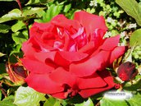
Welcome

Slide 2
Teacher’s introductn
Md. Sirajul Islam
Assistant Teacher
Ahsania secondary school
Mobile no : 01720589966

Slide 3
Lesson’s introduction
Class : six
Subject : English 2nd paper
Specific lesson : Adjective
Time : 45 minutes
Date : 21/01/2013

Slide 4

Objectives
By the end of the lesson ss will have
Learnt what is adjective ?
Indentified what kinds of adjective are ?
Explained the uses of adjective

Slide 5
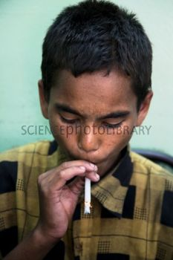
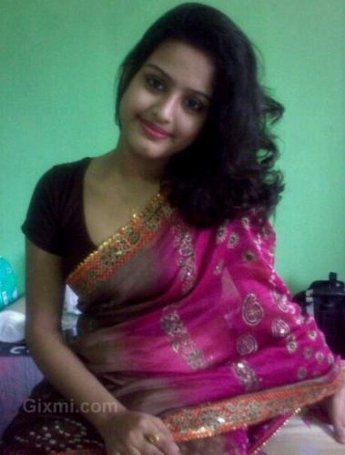
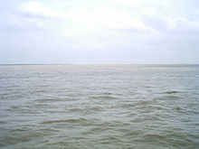
Look at the flowing words and say what are they ?
bad
beautiful
He is a bad boy
big
Lipy is a beautiful girl.
The padma is a big river

Slide 6
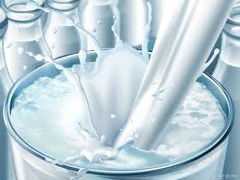
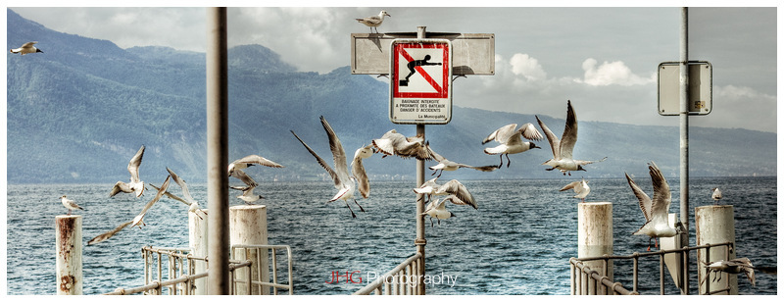
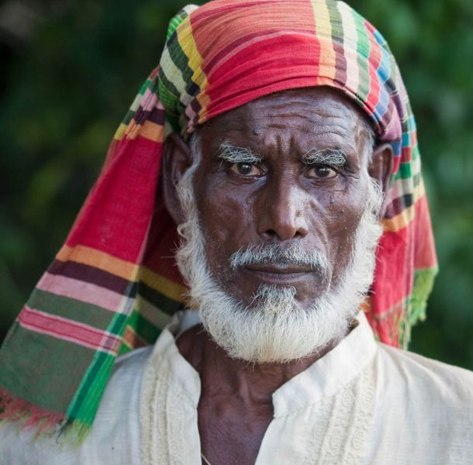
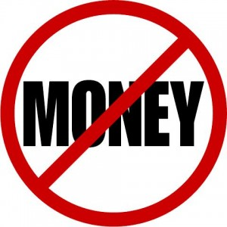
Much milk
Few birds
Old man
No money

Slide 7
Today’s Lesson
Adjective

Slide 8
Definitions of adjective
An adjective only say about noun and pronoun. That may be : good, bad, big, some, little, no, five, 10th , all, my which, this, very, own, etc.

Slide 9
There are six kinds of adjectives such as
Adjective of quantity
Adjective of quality
Adjective of number
Pronominal adjective
Emphasizing adjective
Proper adjective

Slide 10

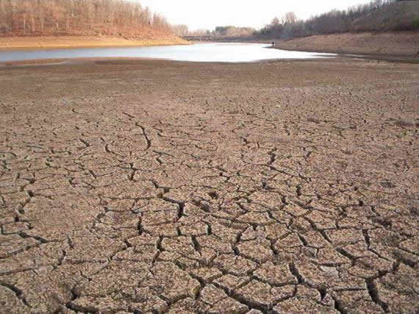
Adjective of Quantity
An adjective that identifies the quantity of a person or anything is called adjective of quantity.
some
Little
There is little water in the field.
Give me some money

Slide 11
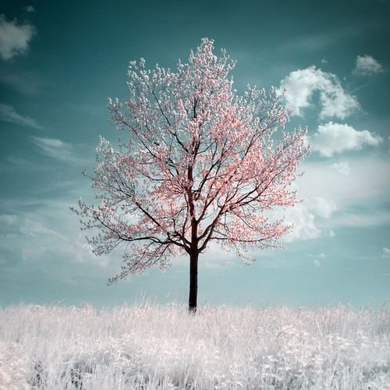
Adjective of Quality
An adjective that shows the quality a person or anything is called adjective of quality.
beautiful
big
It is a beautiful sight.
The padma is a big river.

Slide 12
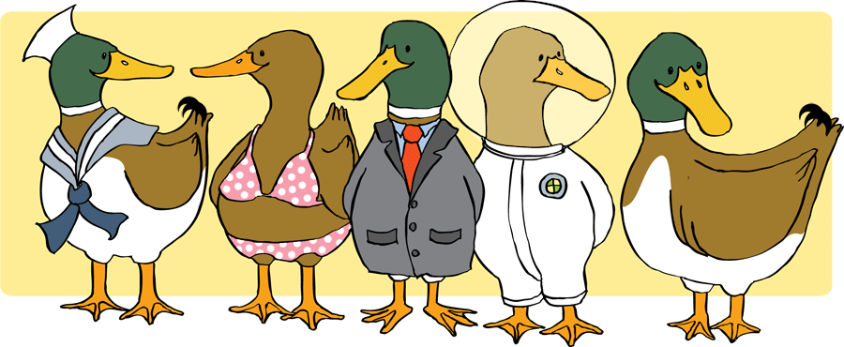
Adjective of number
An adjective that shows number of a person or anything is called adjective of number.
five
She has fives ducks.

Slide 13

Pronominal Adjective
When any pronoun sits before noun and works as an adjective is called pronominal adjective.
my
These are my books.

Slide 14
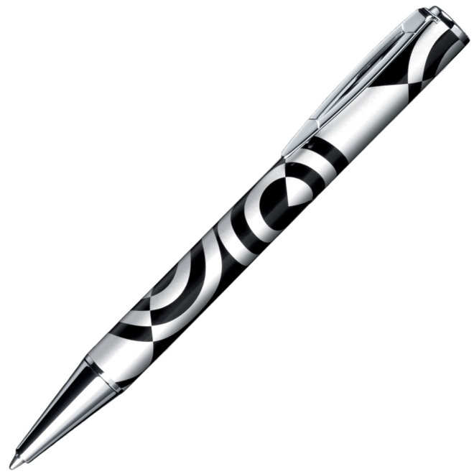
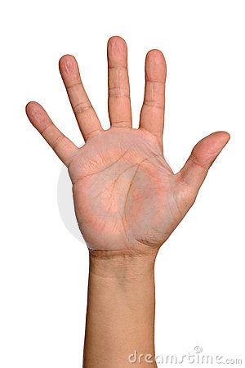
Emphasizing Adjective
When an adjective sits before noun and forced on, it is called emphasizing adjective.
pen
hand
This is the very pen which I want
I did the work with my own hand.

Slide 15
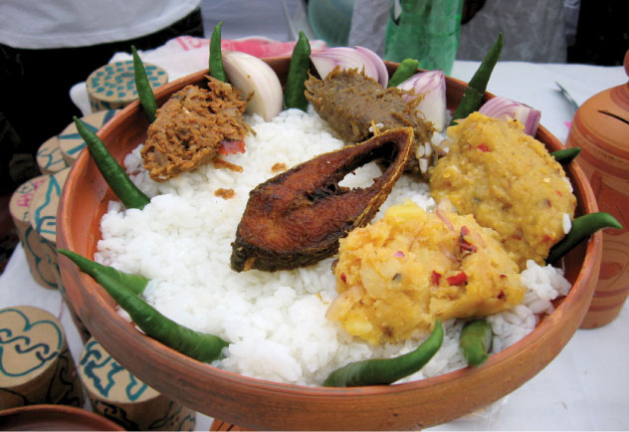
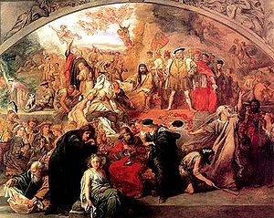
Proper adjective
When an adjective is formed from proper noun is called proper adjective.
Shakespearean drama
Bangladeshi food
These are Bangladeshi foods.
I like Shakespearean dramas.

Slide 16
Group work
Group-A
Group-B
Give the definition and example of – proper adjective and pronominal adjective
Give the definition and example of- adjective of number and adjective of quality.

Slide 17
Evaluation
Questions :
What is adjective ?
What kinds of adjective are ?
Identify the adjectives from the following underlined words.
I have no money.
This is a good book.
All men must die
Which pen do you want ?

Slide 18
Home Task
An adjective is used in a sentence in different ways - explain your opinion

Slide 19
Thanks
Good bye

